Slide 1
Introduction to Greedy Approach, Greedy Coin Change, Greedy Bin Packing

Slide 2
Greedy Algorithm
Greedy algorithms make the choice that looks best at the moment.
This locally optimal choice may lead to a globally optimal solution (i.e. an optimal solution to the entire problem).

Slide 3
When can we use Greedy algorithms?
We can use a greedy algorithm when the following are true:
The greedy choice property: A globally optimal solution can be arrived at by making a locally optimal (greedy) choice.
The optimal substructure property: The optimal solution contains within its optimal solutions to subproblems.

Slide 4
Designing Greedy Algorithms
Cast the optimization problem as one for which:
we make a choice and are left with only one subproblem to solve
Prove the GREEDY CHOICE
that there is always an optimal solution to the original problem that makes the greedy choice
Prove the OPTIMAL SUBSTRUCTURE:
the greedy choice + an optimal solution to the resulting subproblem leads to an optimal solution

Slide 5
Example: Making Change
Instance: amount (in cents) to return to customer
Problem: do this using fewest number of coins
Example:
Assume that we have an unlimited number of coins of various denominations:
1c (pennies), 5c (nickels), 10c (dimes), 25c (quarters), 1$ (loonies)
Objective: Pay out a given sum $5.64 with the smallest number of coins possible.

Slide 6
The Coin Changing Problem
Assume that we have an unlimited number of coins of various denominations:
1c (pennies), 5c (nickels), 10c (dimes), 25c (quarters), 1$ (loonies)
Objective: Pay out a given sum S with the smallest number of coins possible.
The greedy coin changing algorithm:
This is a Θ(m) algorithm where m = number of denominations.
while S > 0 do
c := value of the largest coin no larger than S;
num := S / c;
pay out num coins of value c;
S := S - num*c;

Slide 7
Example: Making Change
E.g.:
$5.64 = $2 +$2 + $1 + .25 + .25 + .10 + .01 + .01 + .01 +.01

Slide 8
Making Change – A big problem
Example 2: Coins are valued $.30, $.20, $.05, $.01
Does not have greedy-choice property, since $.40 is best made with two $.20’s, but the greedy solution will pick three coins (which ones?)

Slide 9


Slide 10
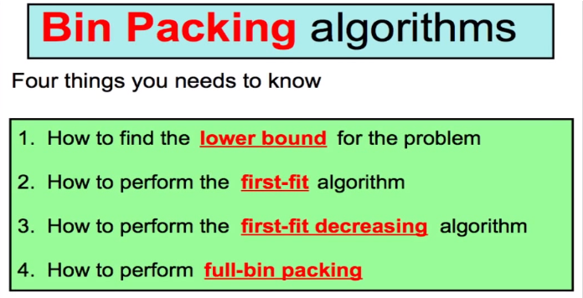

Slide 11
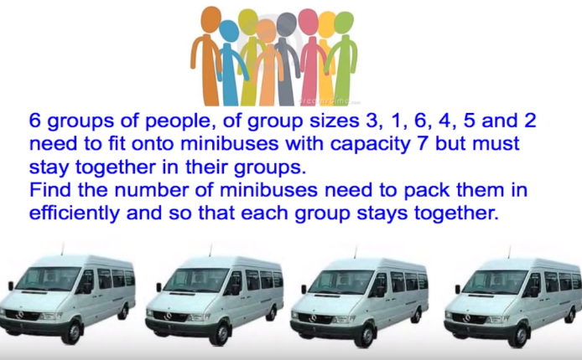

Slide 12
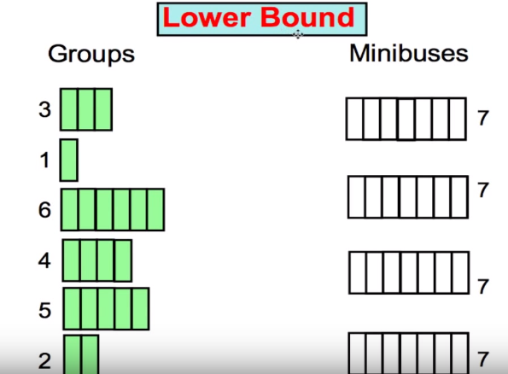

Slide 13
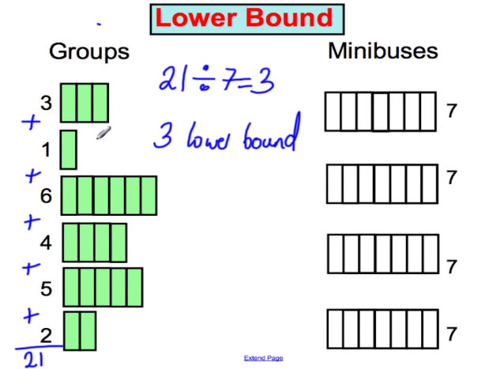

Slide 14
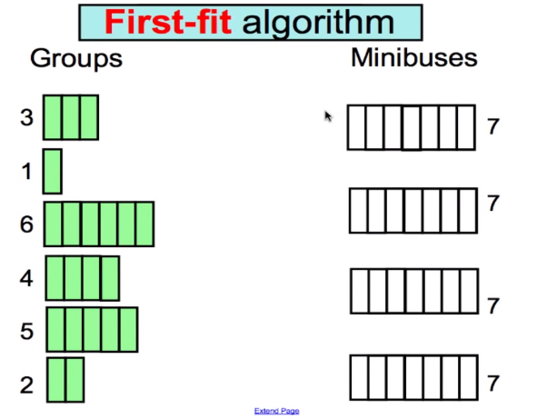

Slide 15
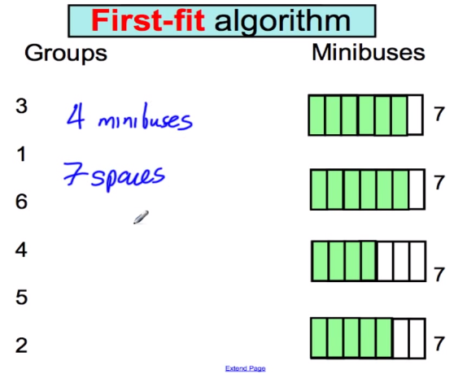

Slide 16
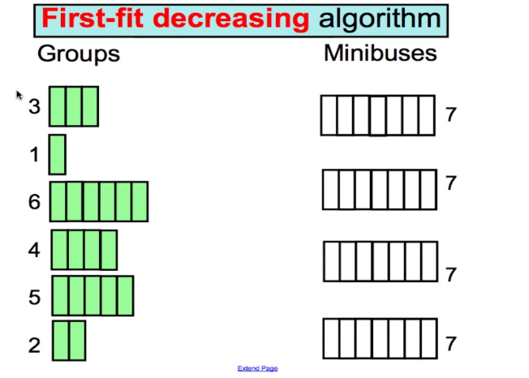

Slide 17
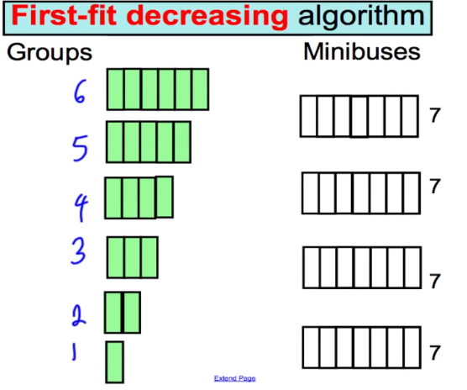

Slide 18
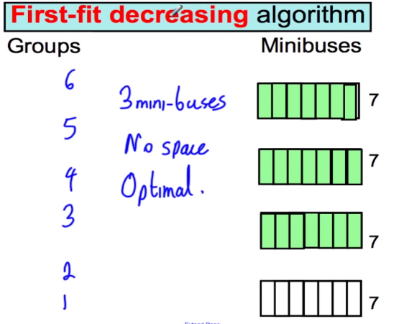

Slide 19
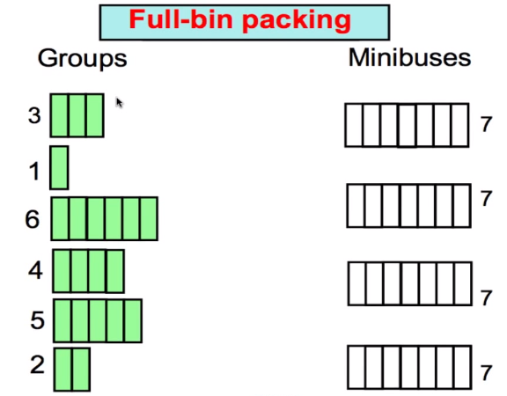

Slide 20
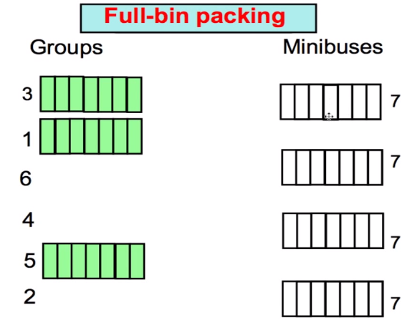

Slide 21
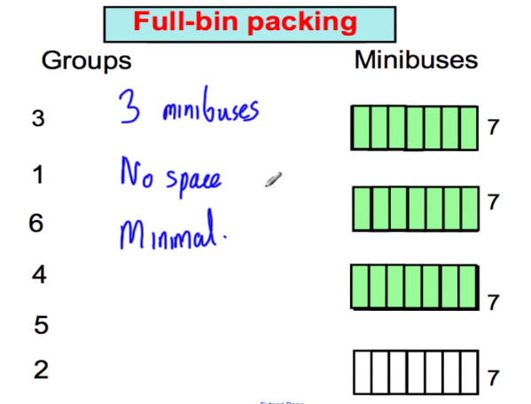

Slide 22
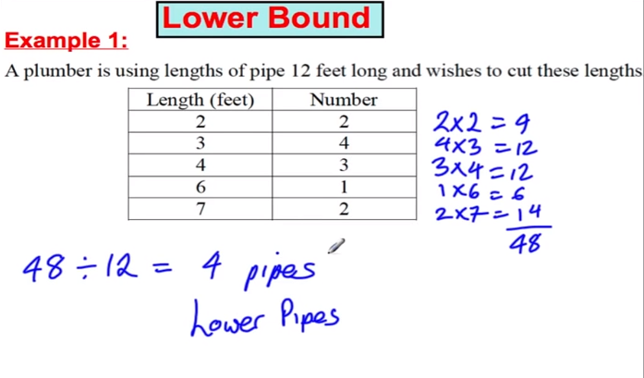

Slide 23
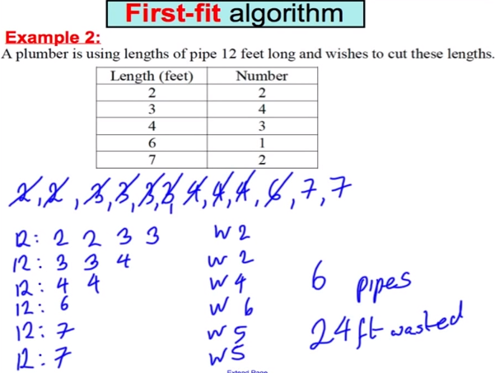

Slide 24
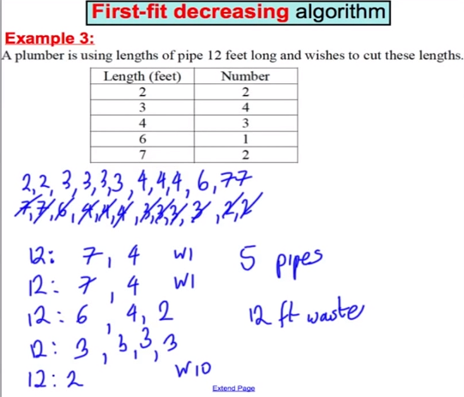

Slide 25
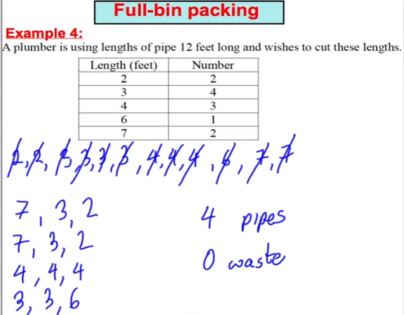

Slide 26
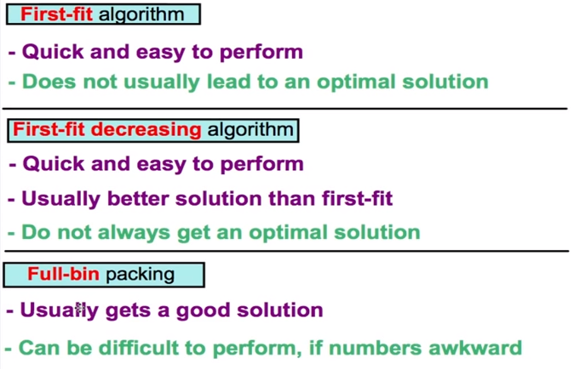

Slide 27
Textbooks & Web References
Text Book (Chapter 16 and 35)
Reference book iii (Chapter 17)
www.geeksforgeeks.org

Slide 28
Thank you
&
Any question?

